Slide 1
A Practical Guide to AB Test in Python

Slide 2
Content
1
5
Experiment Overview
Post Test
2
6
Stages Of AB Test
Conclusion
3
Pre Test
4
At-Test

Slide 3
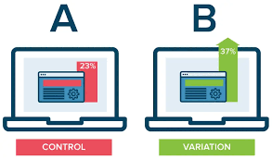
Experiment Overview
The objective of the experiment is to assess whether simplifying the checkout process on the website can lead to an increase in the conversion rate, specifically the percentage of visitors who complete a purchase.
Hypothesis:
The hypothesis states the expected effect of the change.
For example, "We hypothesize that by simplifying the checkout process, reducing the number of steps and removing unnecessary form fields, the conversion rate will increase as more visitors complete their purchases."
A
Control
Existing checkout Process
Experiment Design
Treatment
Simplified checkout Process
B

Slide 4
Stages of AB Test
PRE TEST
AT TEST
POST TEST
Defining Goal, Choosing metrics and parameters.
SRM Check and Analysis
Data collection

Slide 5

Pre-Test
What is the goal of the study ? How we are going to measure success?
Calculating sample size with the chosen parameters
Goal of the Study
Check if simplifying the checkout process increases the conversion rate
Metric
Conversion Rate = Total number of people who made a purchase / total number of people who saw the checkout page
Parameters
The significance level
( alpha ) = 0.05
The statistical power = 80% or 0.8
The minimum detectable effect = 0.05
We will be going through a python script to calculate the sample size required as per the parameters
(click on the box for colab notebook)

Slide 6
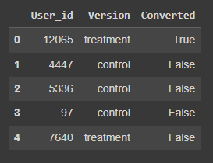
At-Test
We roll out the test and initiate the data collection process.
We simulate the Data Generation Process (DGP) and artificially create variables that follow specific distributions.
There are three variables to be simulated in our case study:
User-id
Version
Conversion
How participants are divided into control and treatment
The participant was assigned with control or treatment
The person chose to perform the desirable action or not ( in this case make a purchase )
We will be going through a python script to simulate the data generation process
(click on the box for colab notebook)

Slide 7
Post-Test
After collecting enough data, we move to the last stage of experiments, which is data analysis.
Start
SRM CHECK
SRM Check
Performing a Chi-Square Test between actual split and the expected split ( 50/50 ) of the treated and control units.
The alpha level is set at 0.001 to test SRM
Analysis
Hypothesis Test to analyse which version is performing better
Using Logistic regression to analyse how conversion rate is affected by different features in the dataset
ANALYSIS
Conclusion
End
We will be going through a python script to understand SRM Check and analysis
(click on the box for colab notebook)
Notes:
SRM Check : Simple ratio mismatch check
It is done to check if the populations in the control and treatment group are comparable or not. And if there is any issue with how participants are being diverted into the two groups
Bootstrapping : Bootstrap can answer these questions. It is a resample strategy that repeatedly samples from the original data with replacements. According to the Central Limit Theorem, the distribution of the resample means approximately normally distributed

Slide 8
Conclusion
The p-value from the simulations hypothesis test is 0.0023, while the p-value from the built-in function is 0.0035. These p-values are reasonably close, indicating consistency between the two methods and providing further validation of the results.
The logistic regression model's analysis reveals the positive coefficient of 0.1327 associated with the group feature suggests that the treatment group has a higher probability of conversion compared to the control group.
In summary, the results from both the simulations hypothesis test and the logistic regression model support the conclusion that the treatment group has a higher probability of conversion compared to the control group but as our MDE is 0.05 and on average we see a change of 0.02 between the control and treatment group we will not deploy this change.

Slide 9
Thank You

